Slide 1
2020 BGC FO Learning Review– Apr.28.2020
LIU Lin, XU Ziyuan, ZHANG Shishi, ZHANG Jialong
Mentor: QIU Yue(Grace)

Slide 2
Agenda
Topics | Presenter | Time
Learning C# Programming | Jialong ZHANG | 5 min
Individual Projects | Ziyuan XU | 5 min
Windows Forms Applications | Lin LIU | 5 min
Quality Management | Shishi ZHANG | 5 min
Q&A | All | 10 min

Slide 3
C# Programming
Jialong ZHANG

Slide 4

Daily Schedule
Daily Stand-up Meeting 9:00 – 9:30
WeChat Voice Call; Context and Knowledge Sharing by Grace; Status Sharing; Plan Making;
Daily Review 18:00
Status Sharing in WeChat; Code Review; Interactive Real-Time Learning; Help Session;
Free Discussion Chatroom all-day

Slide 5

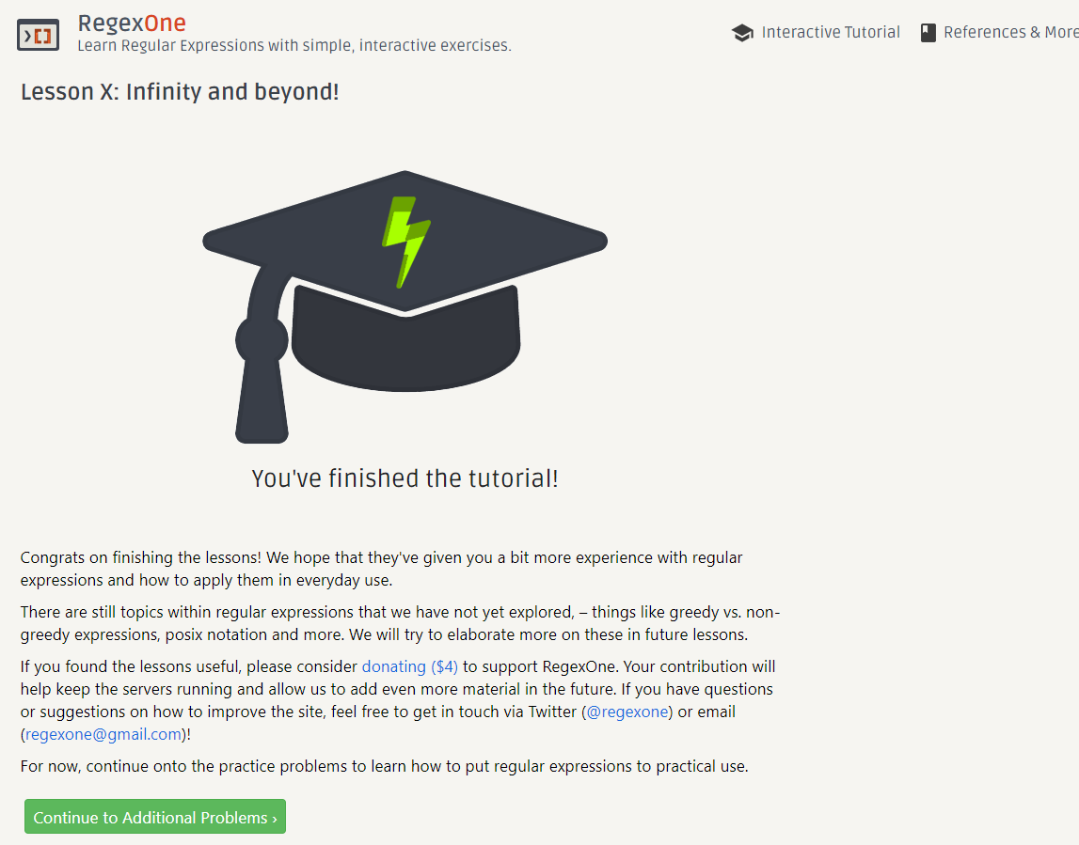
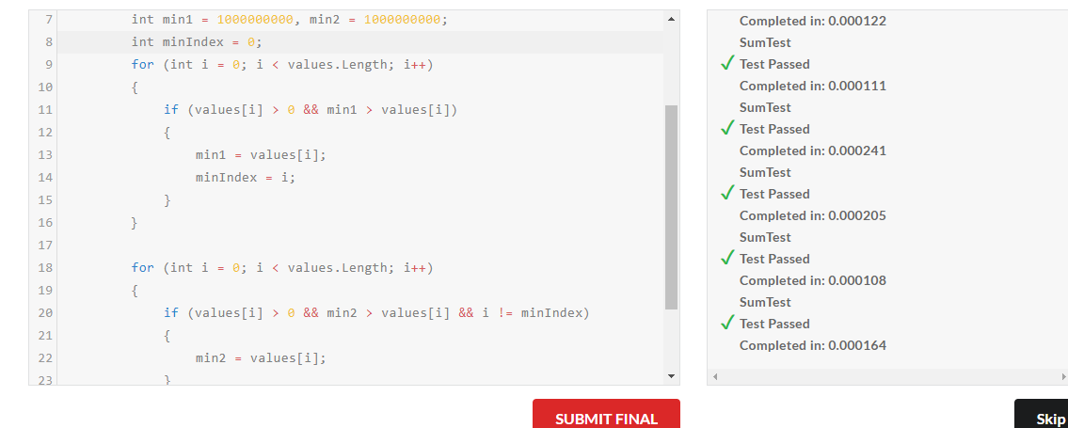
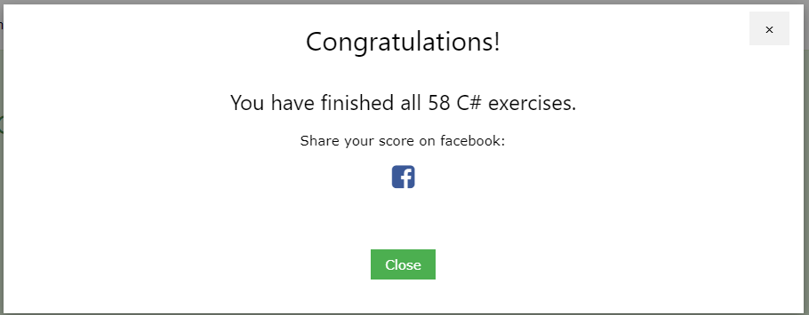
Learning the C# Language
Text book: Illustrated C# 7 (C#图解教程）
https://github.com/Archangelxzy/Csharp--/blob/master/ReadNote.md by LIU Lin
Programming Practices: Edabit, Leetcode, etc.
https://github.com/jzhang182
Further learning materials: Microsoft documents, Pluralsight, etc.

Slide 6
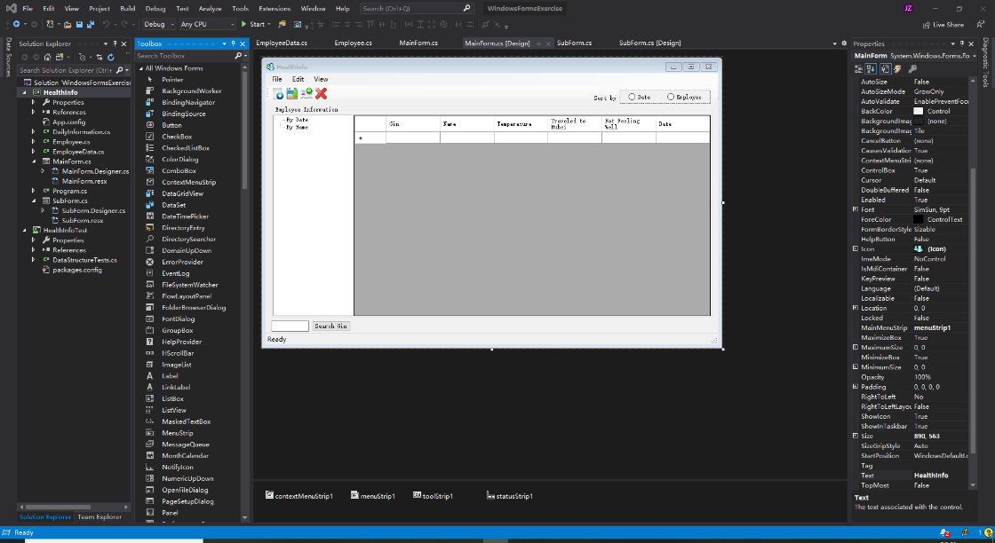
Softwares and extensions usage
Coding: Visual Studio Code, Visual Studio 2019 Community
Quality Management: OpenCover, Xmind,

Slide 7
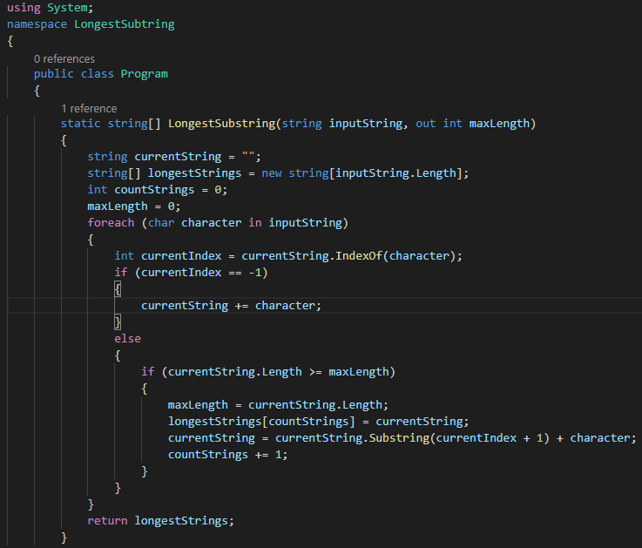
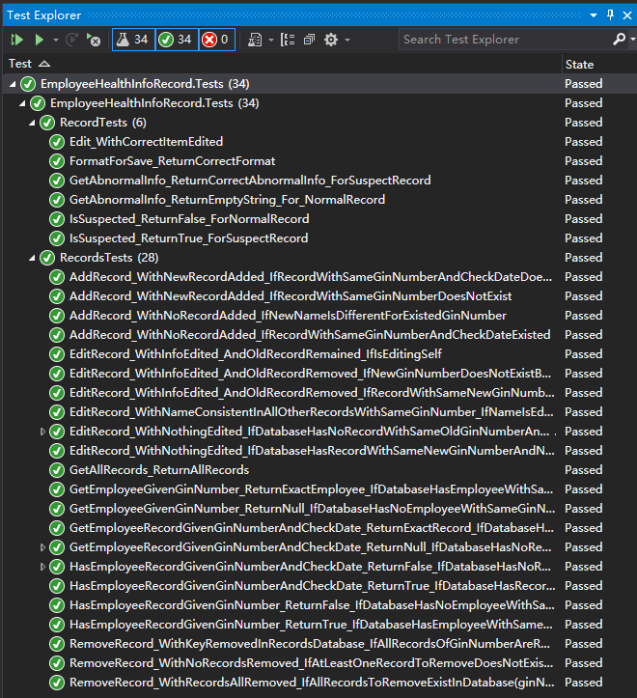
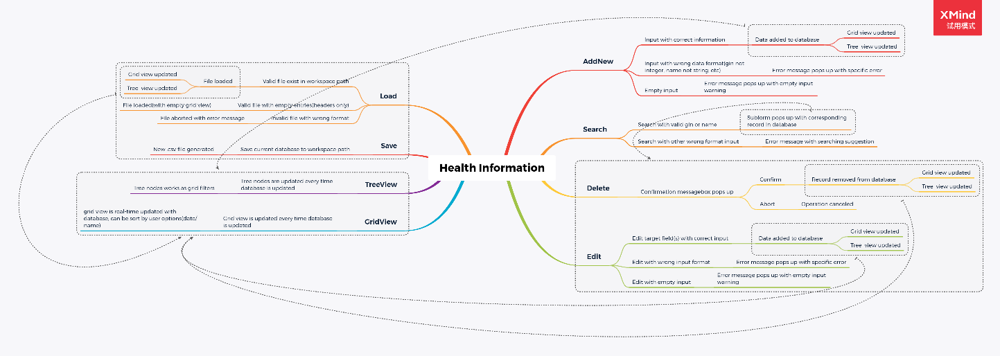
Individual Projects and Testing
Coding exercises and challenges
Algorithms: Searching, Sorting, etc.
Performance: Speed, Stability
User Friendly: Naming and coding rules, code review
Console Apps
Trajectory Views
Health Records System
Unit testing and UX
Windows Forms Apps
Health Records System
Test Cases
MindLine

Slide 8
Windows Forms Applications – case: Daily Health Monitor
LIU Lin
Notes:
Thank you Ziyuan.
And hello everyone, my name is Lin,
The topic I going to talk about is windows forms applications, all through the case of the Daily Health Monitor,
and I think you all have already knowledge of how the system work and behave as a console application with the introduction of ziyuan.
Well, the windows forms applications could be then considered as an application that can do what the console application can do,
but also is wrapped up by GUI (graphical user interface) for the convenience of users.

Slide 9
Objective
Learn building graphically rich interactive applications
Learn Windows Forms programming
Windows Forms controls
Handling of user inputs, event handlers
UI & UX design
Learn quality management
Notes:
One objective of the study is obviously learning how to build such graphically rich interactive applications that meet the requirements, and also are easy to use even for non-technical users.
one way to build such type of window-based application is by using windows forms programming,
In detail, it includes learning how to use different windows forms controls, box, table,
learning how to handle user inputs, valid or invalid,
learning event handlers, how the interface should interact after operations of users, and also, learning the UI & UX design to build a user-friendly application.
Compare to console application, GUI application means more codes to implement and maintain, and also more possibilities to have bugs or errors during the development, quality management is the way to assure the usability and quality of large projects.

Slide 10
Daily Health Monitor - Requirements
Basic operations: Add, Edit, Delete, Load, Save
Filters: Date, Name, GinNumber, Suspects
User Experience
Shortcuts support
Error messages
Full-featured, but also easy to use
Notes:
As said previously, the application should at least meet the requirements of users.
In this example, we should sort out the requirements first before building the application.
First of all, the application should allow users to do basic operations to the records database, add, edit or delete specific record, load database from file, save database to file.
Secondly, users could search or filter specific types of records through date, name, ginNumber, or filter only those suspect records if users want to.
And at last, for good user experience, shortcuts support and error messages for invalid operations are necessary, and all these are for making the application full-featured while still easy to use.

Slide 11
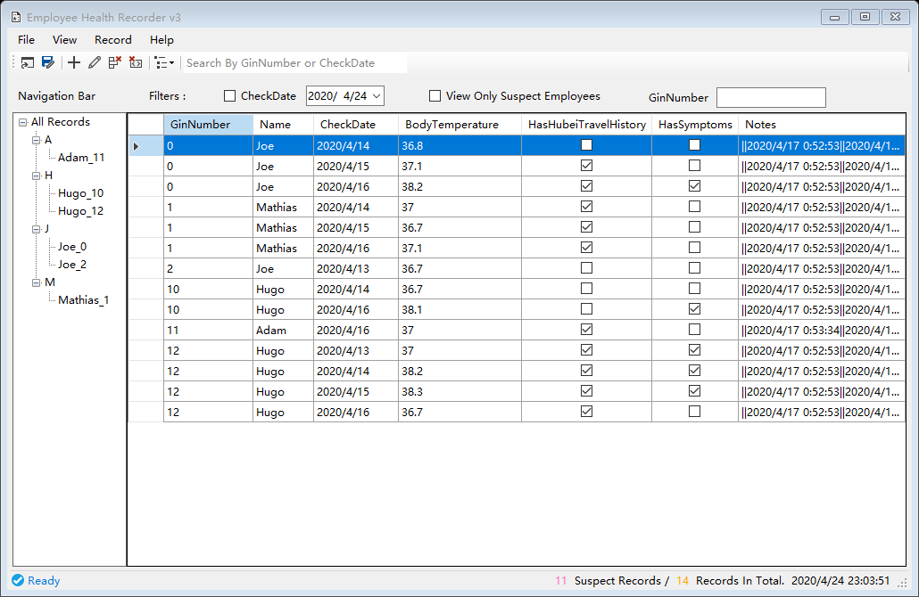
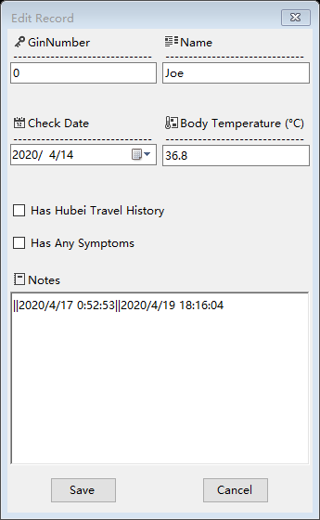
Daily Health Monitor - Solution
Records Explorer
Record Editor
Notes:
And we finally proposed such a solution for those requirements after continuous improvement, including basically two forms.
one is the records explorer, which allows users to view all records or special records in a single table with the help of different filters and navigation sidebar.
And also support quick operations of adding, editing or deleting through key shortcuts and convenient tool and menu bars.
The form on the side is the record editor, designed for adding and editing specific record, and it supports error message warning for invalid operations and user inputs.

Slide 12
Daily Health Monitor - Demo

Slide 13
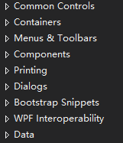
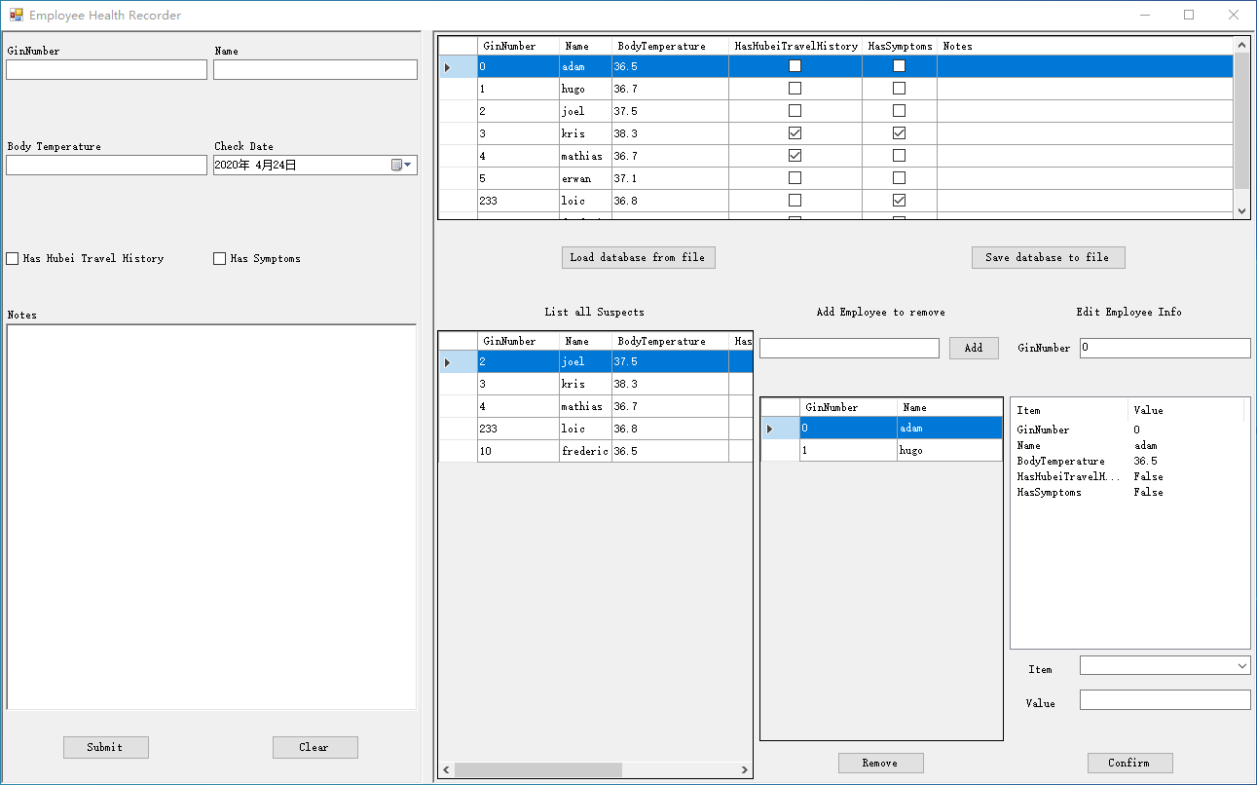
Daily Health Monitor - Conclusion
Take one month from beginning to a deliverable application
What we have learned
Windows Forms programming
Good UI & UX design
Continuous Development & Continuous Testing
List of controls
Solution v0
Notes:
This application takes about one month from zero knowledge to GUI programing, to an usable application, shown as solution v0 here, you can see the interface is rather complicate and confusing for users
, and finally to the final deliverable application, which is much cleaner.
During the study, we have learned the basic windows forms programing, which already enables us to build a featured application.
And we also learned good UI & UX design, which is one of important things for what we call a “good product”.
And finally we made great effort for continuous development and continuous testing, to ensure usability and quality of this application.

